Slide 1



20EC5203 ELECTRONIC DESIGN PROJECT- I
MODULE 1 – REMOTE CONTROL LIGHT MODULE 2 – WATER TAP AUTOMATION
Presented by:
NITHISH RAGHAVENDAR T.K (811722106068) SHOBAN BABU YJ (811722106102) SUBHARAM K.T.R(811722106111)
Under the Guidance of Dr.M.ASHOK RAJ M.E.,(PhD).,
Assistant Professor Department of ECE
1
12/6/2024

Slide 2


OUTLINE
ABSTRACT –MODULE 1
INTRODUCTION
OBJECTIVE AND SCOPE
BLOCK DIAGRAM
HARDWARE MODULE
ADVANTAGES AND APPLICATIONS
ABSTRACT –MODULE 2
INTRODUCTION
OBJECTIVE AND SCOPE
BLOCK DIAGRAM
HARDWARE MODULE
ADVANTAGES AND APPLICATIONS
CONCLUSION
2
12/6/2024
❑ REFERENCES

Slide 3
MODULE 1 –REMOTE CONTROL LIGHT

Slide 4
ABSTRACT - MODULE 1
This project presents the design and implementation of an infrared (IR) remote-controlled lighting system aimed at enhancing convenience in controlling electric lamps from a distance. The system consists of a handheld transmitter that emits IR signals and a receiver connected to the lamp. When a button on the remote is pressed, it sends modulated IR pulses to the receiver, which decodes the signals and activates or deactivates the lamp accordingly. This setup allows users to control lighting from distances of up to 200 meters, eliminating the need for manual operation. The project not only demonstrates practical applications in home automation but also serves as an educational tool, providing insights into IR communication technology and electronic system design.

Slide 5
INTRODUCTION – MODULE 1
In today’s fast-paced world, the demand for convenience and automation in everyday tasks has become increasingly prevalent. One area where this demand is particularly evident is in the control of lighting systems. Traditional methods of operating lights—such as switches—can be cumbersome, especially in larger spaces or for individuals with mobility challenges. To address these issues, the development of remote- controlled lighting systems has gained traction, offering a more user-friendly and efficient solution.This project focuses on creating an infrared (IR) remote-controlled lighting system that allows users to operate electric lamps from a distance. Utilizing IR technology, the system comprises two main components: a handheld remote transmitter and a receiver connected to the lamp. The transmitter emits infrared signals that are detected by the receiver, which then activates or deactivates the lamp based on the received commands.The use of IR communication technology is advantageous due to its simplicity, reliability, and cost-effectiveness.

Slide 6
OBJECTIVE AND SCOPE
Objective :
The objective of remote control lighting systems is to enhance user convenience and energy efficiency by allowing users to operate lights from a distance, integrating them into smart home environments, and improving overall accessibility. This technology enables users to turn lights on or off, adjust brightness, and even change colors through various control methods, including infrared remotes or mobile applications. By automating lighting, users can optimize energy consumption, reduce costs, and enhance security through programmable settings that simulate occupancy when away from home.
Scope of the Project :
Technology Integration: Use infrared (IR) or radio frequency (RF) for remote operation.
System Design: Develop transmitters and receivers for communication.
Mobile App Control: Create apps for smartphone lighting control.
Installation Compatibility: Ensure easy installation with various fixtures.
Customization Options: Allow users to set schedules and scenes.

Slide 7
LITERATURE SURVEY
Ref. No | Title & Author | Methodology or Components Used | Pros | Cons
1 | Title: Infrared Sensor Based Light Control System Using Microcontroller Authors: K. A. Chidambaram, R. N. Rao, S.V. S. S. P. Rao | Microcontroller (8051) and IR sensor for automatic light control | Simple circuit design , Cost-effective solution , and Energy-saving by automatically switching off lights | Limited range of IR sensor May not work effectively in bright ambient light
2 | Title: Design and Implementation of an IR Remote Controlled Home Automation System Authors: J. B. Singh, R. P. Singh, A. S. R. Bhadauria | IR remote control, microcontroller (PIC16F84A) | Wireless control and Can control multiple devices with a single remote | Limited range of remote control Possible interference from other IR sources
3 | Title: Smart Home Automation System Using IR Sensors Authors: L. K. Pandey, S. K. Gupta, A. K. Sing | IR sensors for light detection, microcontroller for automation | Improves energy efficiency Remote control using IR sensors reduces manual operation | Requires clear line-of-sight for IR communication Sensitivity to environmental factors like walls or obstructions
4 | Title: Automatic Street Lighting System Using IR Sensors Author: P. R. Patel, A. S. Thakkar | IR sensors combined with a relay and microcontroller | Effective for street lighting, saving energy • Can adjust lighting based on movement | Power consumption by IR sensors and microcontroller Environmental factors may affect sensor performance
5 | Title: IR Based Light Control for Home Automation Author: S. S. Shinde, P. M. Hande | IR sensors and relay for controlling lights through a microcontroller | Low-cost implementation Easy to install and manage | Sensitivity to interference from other IR devices Range limitations of IR sensor

Slide 8
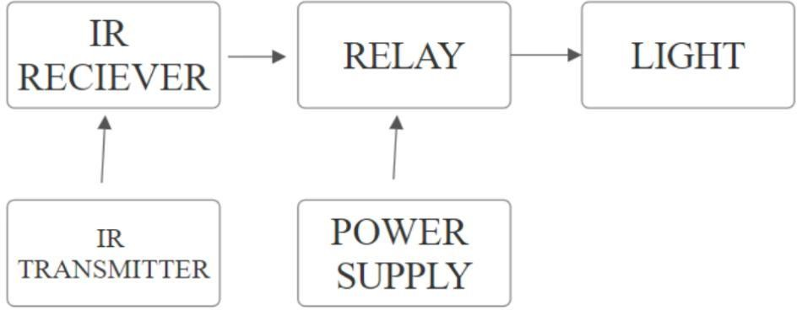
BLOCK DIAGRAM

Slide 9
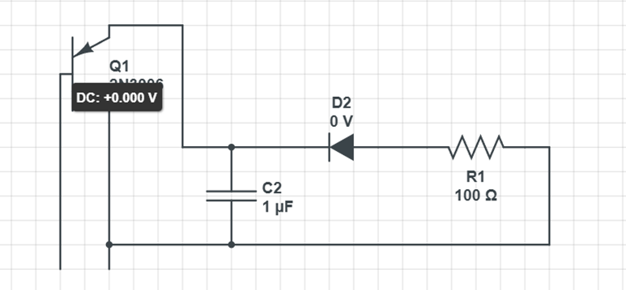
CIRCUIT DIAGRAM

Slide 10
HARDWARE MODULE
1. Bread Board
2. 1N4007 Diode
3. Capacitor (47mF)
4. LED
5. Resistor
6. TSOP 1738
7. Connecting Wires

Slide 11
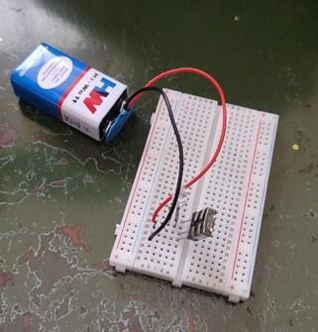

Slide 12
ADVANTAGES AND APPLICATIONS
Advantages:
Energy Efficiency: Reduces electricity consumption, leading to lower energy bills.
Convenience: Allows easy control from a distance via mobile apps or remotes.
Enhanced Security: Automates lighting to simulate occupancy, deterring intruders.
Customization: Enables scheduling and scene setting for tailored lighting experiences.
Longer Lifespan: LED smart bulbs last significantly longer than traditional bulbs.
Applications:
Smart Homes: Integrated into home automation systems.
Security Systems: Enhances safety through automated lighting.
Commercial Spaces: Improves energy management in offices and retail.
Event Lighting: Customizable setups for various events.
Outdoor Lighting: Provides ease of control for landscape and pathway lights.

Slide 13
MODULE 2 – WATER TAP AUTOMATION

Slide 14
ABSTRACT - MODULE 2
Water tap automation leverages advanced sensor technology to control the flow of water without the need for manual operation. This innovative system typically employs infrared sensors or other detection methods to identify user presence, activating the tap automatically when hands are detected and shutting off when they are removed. The primary goals are to enhance convenience, promote water conservation, and improve hygiene by minimizing contact with surfaces. Automated water taps are increasingly being adopted in various settings, including residential homes, public restrooms, and commercial facilities, contributing to sustainable practices and better user experiences. By integrating these systems into everyday environments, we can significantly reduce water wastage and foster a culture of sustainability.

Slide 15
INTRODUCTION – MODULE 2
As global water scarcity becomes a pressing issue, the need for efficient water management solutions has never been more critical. Traditional manual taps often lead to excessive water wastage due to forgetfulness or improper usage. In response, water tap automation systems have emerged as a practical solution that not only conserves water but also enhances hygiene by reducing touchpoints. These systems utilize modern technologies such as infrared sensors, which detect motion and presence, allowing for hands-free operation. With the increasing emphasis on health and cleanliness—especially in public spaces—automated taps provide a hygienic alternative that aligns with contemporary needs.

Slide 16
OBJECTIVE AND SCOPE
Objective:
The primary objectives of water tap automation are to minimize water wastage by ensuring that taps operate only when needed, enhance hygiene by reducing contact with surfaces, and provide a convenient solution for users in various environments. Additionally, the system aims to be cost-effective and accessible, allowing widespread adoption in both public and private facilities.
Scope:
Sensor Technology: Implementation of infrared or motion sensors for automatic activation.
System Design: Development of user-friendly interfaces and reliable control mechanisms. 3.Installation: Compatibility with existing plumbing systems for easy retrofitting.
4.Energy Efficiency: Focus on low-power consumption designs.

Slide 17
LITERATURE SURVEY
Reg. No. | Title & Author | Methodology or Components Used | Pros | Cons
1 | "Characterisation of Infrared Sensors for Close-Proximity Distance Measurement" by Brian Azzopardi, Evan Dimech, Andrew Sammut, and Adrian Mifsud | Utilized multiple types of infrared sensors for close-proximity measurements; characterization was performed under varied lighting and environmental conditions. | High accuracy in proximity measurement; robust characterization; effective for industrial applications. | Performance impacted by highly reflective or absorptive surfaces.
2 | "Wireless Infrared Proximity Array Sensor for Three-Dimensional Surface Reconstruction" by S. A. Daud, Nasrul Humaimi Mahmood, and Pei Ling Leow | Developed a wireless proximity array sensor system; employed infrared beams for scanning and reconstructing 3D surfaces with array-based sensing. | Accurate 3D surface reconstruction; wireless capability enhances mobility and usability. | Sensitive to environmental factors such as interference and ambient light variations.
3 | "A Study on the Development of Multi-Stage Solenoid Valve" by Chan Se Jeong, Hak-Sun Kim, and Soon-YongYang | Designed a multi-stage solenoid valve with enhanced flow control capabilities, focusing on performance optimization through valve mechanics. | Improved flow control accuracy; reduced energy consumption; effective for industrial fluid systems. | Complexity in design increases manufacturing cost; requires precise calibration.
4 | "Design of Automatic Controlling System for Tap-Water Using Floatless Level Sensor" by S. M. Matiur Rahman et al. | Designed an automatic water-level control system using a floatless level sensor integrated with control electronics for efficient water management. | Eliminates need for mechanical floats; highly reliable and maintenance-free design; efficient water management. | Limited application in high- turbulence water environments; may require regular calibration for consistent operation.
5 | "Design, Control, and Comparison of Low- Energy Solenoid Valve Actuators" by J. van Dam, B. Gysen, M. Dhaens, and E. Lomonova | Developed low-energy solenoid valve actuators and compared their performance with conventional designs; focus on reducing energy consumption while maintaining performance. | Significantly reduced energy consumption; compact design with enhanced actuator efficiency; eco-friendly approach. | May have limitations in scalability for high-power applications; performance degradation in extreme environmental conditions.

Slide 18
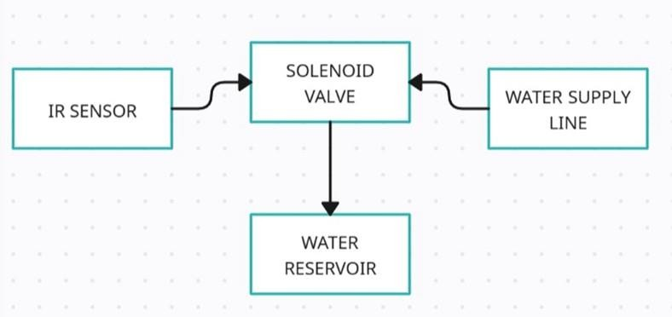
BLOCK DIAGRAM
21

Slide 19
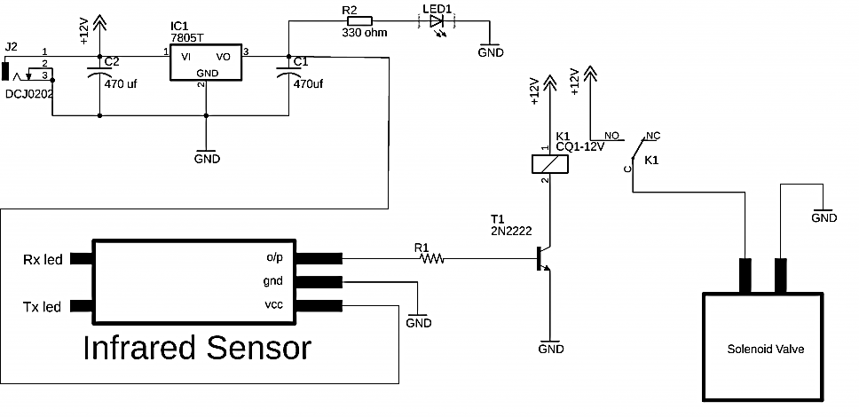
CIRCUIT DIAGRAM
21

Slide 20
HARDWARE MODULE
IR Proximity sensor
12V Solenoid valve
Resistor
Diode 1N4007
TIP122 NPN Diode
TIP32C PNP Transistor
DC Connector
DC Adapter
BreadBoard
Connecting Wires
21

Slide 21
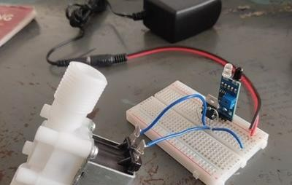
21

Slide 22
ADVANTAGES AND APPLICATIONS
Advantages
1.Water Conservation: Significantly reduces water wastage by controlling flow based on user presence. 2.Improved Hygiene: Minimizes contact with surfaces, lowering the risk of germ transmission.
3.Convenience: Offers hands-free operation for ease of use in various settings. 4.Energy Efficiency: Often designed to operate on low power, reducing energy costs.
5.Durability: Typically constructed from corrosion-resistant materials for long-lasting use.
Applications
1.Public Restrooms: Enhances hygiene and reduces water usage in high-traffic areas. 2.Residential Use: Provides convenient solutions for kitchens and bathrooms.
3.Commercial Facilities: Ideal for restaurants, hotels, and shopping complexes where hygiene is paramount.
22
4.Industrial Settings: Useful in factories or laboratories where hands-free operation is beneficial.
12/6/2024

Slide 23
CONCLUSION
Remote control lighting systems represent a significant advancement in home automation, offering enhanced convenience, energy efficiency, and security. By enabling users to control their lighting remotely through mobile applications or dedicated remotes, these systems provide an unprecedented level of flexibility and customization. The integration of smart technology allows for the automation of lighting based on user preferences and schedules, contributing to energy savings and improved safety. As urbanization continues to rise, the adoption of remote control lighting will play a crucial role in creating smarter, more efficient living spaces.
Water tap automation is a transformative solution addressing critical issues related to water conservation and hygiene in modern society. By utilizing sensor technology to enable hands-free operation, automated taps significantly reduce water wastage while enhancing user convenience and promoting better hygiene practices. The ability to control water flow based on user presence not only conserves this vital resource but also minimizes the risk of germ transmission in public and private spaces.
MODULE 1: https://drive.google.com/drive/folders/16xJupXNtTsUXOkTxQNaNYEzE1gg8nQJF
MODULE 2: https://drive.google.com/drive/folders/16yZExh8P6QX7CgAzI_3fYdN8G5baR6Zg
23
12/6/2024

Slide 24
REFERENCES
Azzopardi, Brian, Evan Dimech, Andrew Sammut, and Adrian Mifsud. "Characterisation of Infrared Sensors for Close- Proximity Distance Measurement." IECON 2023 - 49th Annual Conference of the IEEE Industrial Electronics Society, Oct. 2023.
Camporez, Higor A. F., Yasmim S. Pimassoni, Wesley S. Costa, Marcelo E. V. Segatto, Jair A. L. Silva, and Helder R.
O. Rocha. "Remote Control in Smartphone-Based Visible Light Communications." Journal of Communication Systems, vol. 12, 2021.
Daud, S. A., Nasrul Humaimi Mahmood, and Pei Ling Leow. "Wireless Infrared Proximity Array Sensor for Three- Dimensional Surface Reconstruction." 2014 IEEE 2nd International Symposium on Telecommunication Technologies (ISTT), Nov. 2014.
Jeong, Chan Se, Hak-Sun Kim, and Soon-Yong Yang. "A Study on the Development of Multi-Stage Solenoid Valve."
2010 International Conference on Control, Automation and Systems (ICCAS 2010), Oct. 2010.
Rahman, S. M. Matiur, Md. Abdullah Al Mamun, N. Ahamed, N. Ahmed, Md. Sharafat Ali, and M. Islam. "Design of Automatic Controlling System for Tap-Water Using Floatless Level Sensor." IEEE International Symposium on
24
Robotics and Manufacturing Automation (ROMA), 1 Dec. 2014.
12/6/2024

Slide 25
6. Szente, Viktor, and János Vad. "Computational and Experimental Investigation on Solenoid Valve Dynamics."
Advanced Intelligent Mechatronics, 2001. Proceedings. 2001 IEEE/ASME International Conference on, vol. 1, Feb. 2001.
van Dam, J., B. Gysen, M. Dhaens, and E. Lomonova. "Design, Control, and Comparison of Low-Energy Solenoid Valve Actuators." 2018 IEEE International Magnetics Conference (INTERMAG), Singapore, 2018, pp. 1-2.
Xu, C., Y. Zhou, S. Cai, R. Qin, Y. Liang, and B. Pang. "Designing and Research of a Solenoid Valve Operating Life Test System." 2012 Second International Conference on Instrumentation, Measurement, Computer, Communication and
Control, Harbin, China, 2012, pp. 53-56.
Jeong, Chan Se, Hak-Sun Kim, and Soon-Yong Yang. "A Study on the Development of Multi-Stage Solenoid Valve."
2010 International Conference on Control, Automation and Systems (ICCAS 2010), Oct. 2010.
Fu, Qin, Qibing Lin, and Hanhong Tan. "Multifunctional Intelligent Water Dispenser System." 2023 5th International Conference on Applied Machine Learning (ICAML), July 2023.
25
12/6/2024

Slide 26
THANK YOU
26
012/6/2024

